Slide 1
Credit Worthiness prediction
Live Project 01
Submitted by: Subhransu Sekhar Mallick

Slide 2
CONTENTS
Hypothesis Making : Milestone-01
Exploratory Data Analysis: Milestone-02
Data quality checking
Hypothesis validation
Pre processing and Feature Engineering: Milestone-03
Feature engineering
Feature selection
Model development and Validation: Milestone=04

Slide 3
Milestone-01
Project Milestone-1 has the following objectives
Suggest the probable business impact of each independent feature on the target.
Suggest ways in which the organization can benefit as a result of analyzing the data.
Suggest missing features that can help with the analysis based on business logic.
What is the best way to collect data for the suggested features ?

Slide 4
Milestone-01
Hypothesis:
Loan ID has no relation with the target feature Loan Approval Status.
Gender has low impact on Loan Approval Status.
Married feature has less impact on Loan Approval.
Number of Dependents feature has less impact on Loan Approval.
Good Education has more chances of loan approval.
Self-employed should have lesser chances of loan approval.
Applicants having Credit history should have higher chances of loan approval.
High Applicant Income should have more chances of loan approval.
Applicant with Co applicant Income should have more chances of loan approval.
If the Loan Amount is less, the chances of loan approval should be high.
If the Loan Tenure is less, the chances of loan approval should be high.
Property Area feature has less impact on Loan Approval.

Slide 5
Milestone-01
Benefit from the Data Analysis:
Applicant details together with credit rating may serve as an instrument to find credit worthiness of the applicant.
The credit worthiness differs from individual to individual. The applicants with a high level of risk have higher probability of defaulting their loans.
The low-risk category applicants should get loan approval as the bank consider them creditworthy.

Slide 6
Milestone-01
Features that can be added to the Data:
Applicant’s work experience may ensure reliable source of income and financial stability
Applicants’ employer type may serve an instrument to ascertain job stability.
Applicant’s Age also matters. A loan application in early working stage or nearby retirement years should not be approved.
Applicants with lesser credit score should be asked collateral.
The abovementioned data can be collected from the existing applicants via telephonic conversation/ Email exchange by the lender or authorized agencies and from new applicant while filling of loan application.

Slide 7
Milestone-2
Project Milestone-2 has the following objectives
Data quality checking or Basic sanity checking
Generate your hypothesis on what impact independent features have on the target variable and back that up with insights from the data and highlight major differences from suggested impact in Milestone 1.
Create a report of the aforementioned insights using a visualisation library in Python/PowerBi/Tableau

Slide 8
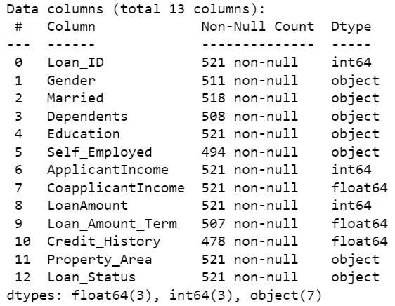
Milestone-2
Insights: The dataset has 521 rows and 13 columns in train dataset.
Categorical features:
Loan_Status
Gender
Married
Self_Employed
Credit_History
Education
Property_Area
Numerical features:
Loan ID
Dependents
ApplicantIncome
CoapplicantIncome
LoanAmount
Loan_Amount_Term

Slide 9
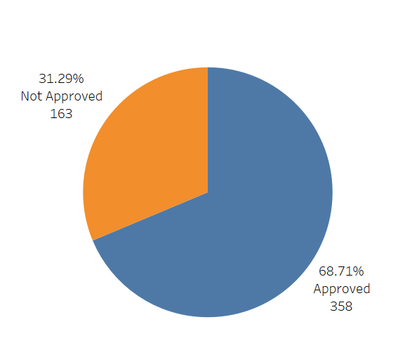
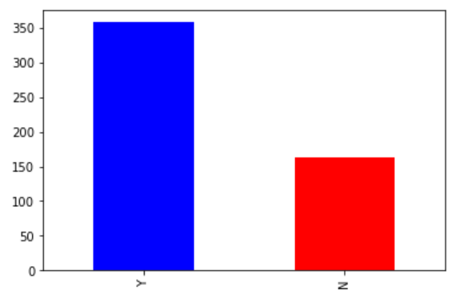
Milestone-2
The loan of 358 applicants i.e around 68.71% out of 521 were approved

Slide 10
Data Quality Issues
Completeness: | Null values in the following columns: Gender (10), Married (03), Dependents (13), Self Employed (27), Loan_Amount_Term (27), Credit_History (43).
Consistency: | Datatype of the Dependents feature is integer however it has text ' 3+'.
Validity: | Many rows of Co-applicant Income have filled with 0s which shows the absence of Co-applicant's income value. Similarly Loan amount column has also '0's which is not valid.

Slide 11
Milestone-2
Following inferences can be made from the Univariate Analysis of Categorical Variables:
80% applicants in the dataset are male.
Around 65% of the applicants in the dataset are married.
Around 15% applicants in the dataset are self employed.
Around 85% applicants have their credit history available.
Around 80% of the applicants are Graduate.
Most of the applicants are having property in Semiurban area.

Slide 12
Milestone-2
Following inferences can be made from the Univariate Analysis of
Numerical Variables:
The data in the distribution of Applicant income & Coapplicant Income is right skewed. The boxplot confirms the presence of a lot of outliers/extreme values.
Most of the applicants don't have any dependents.
The data distribution of Loan Amount is not normally distributed. Lot of outliers is also there in the Loan amount feature.
Majority of applicants have applied loan of 360 months term

Slide 13
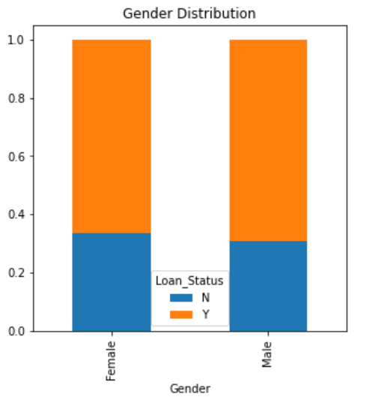
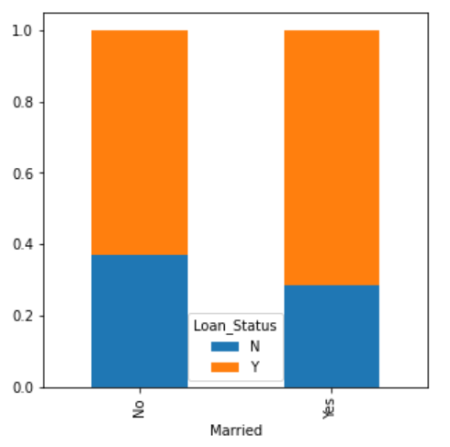
Milestone-2
Bivariate Analysis of Categorical variable
Loan Status by Gender
Loan Status by Marital status
Proportion of male and female applicants is more or less the same for both approved and unapproved loans
Portion of married applicants is higher for approved loans. This contradicts our hypothesis

Slide 14
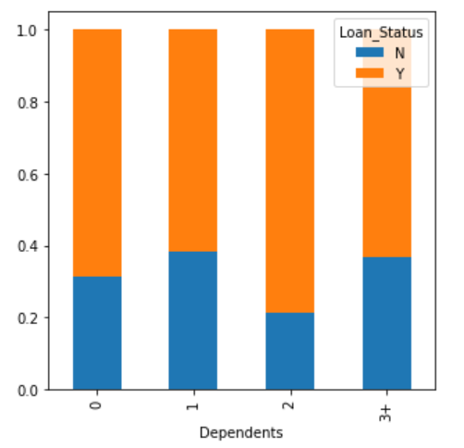
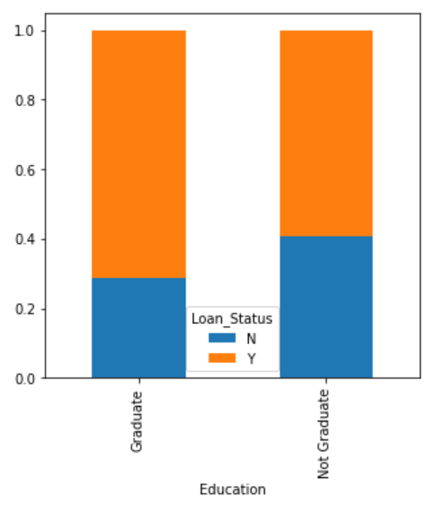
Milestone-2
Loan Status by Dependents
Loan Status by Education
Applicants with 2 dependents have higher loan acceptance than no dependents. Distribution of applicants with 1 or 3+ dependents is similar. This show no conclusive significance
The portion of Graduates have higher loan approvals than non graduates. This supports our hypothesis.

Slide 15
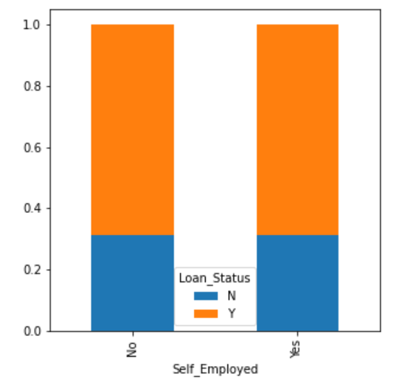
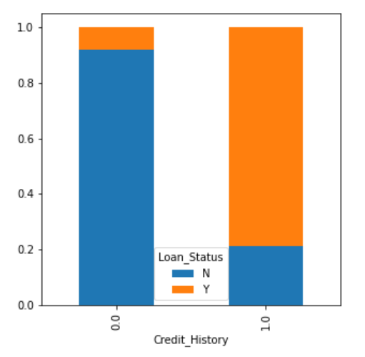
Milestone-2
Loan Status by Selfemployment
Loan Status by Credit History
It shows no impact of self employment on target feature. This Contradicts our hypothesis
It seems people with a credit history as 1 are more likely to get their loans approved.

Slide 16
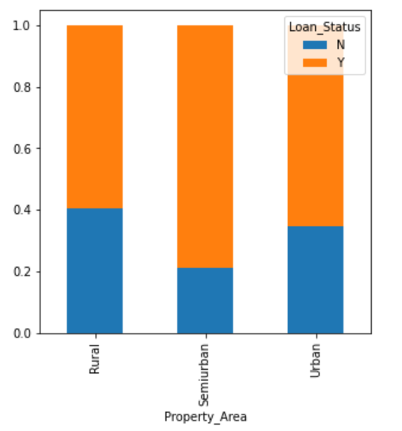
Milestone-2
Loan Status by Property Area
It can be inferred that the proportion of loans getting approved in the semi-urban area is higher as compared to that in rural or urban areas.
This contradicts our hypothesis which says Property area have low impact on Loan approval.

Slide 17
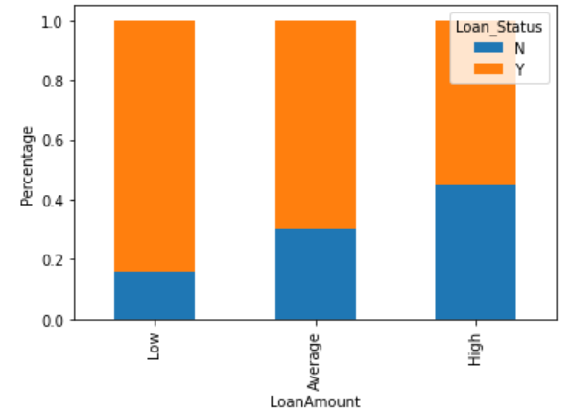
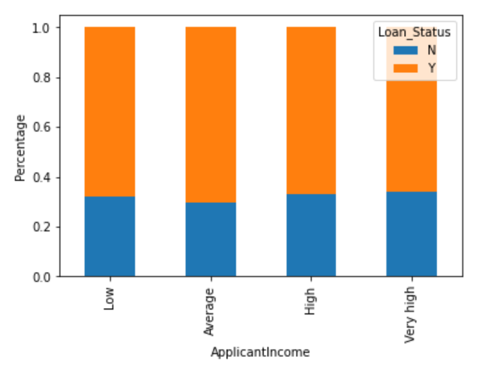
Milestone-2
Bivariate analysis of numerical features
Loan Status by Loan Amount
Loan Status by Applicant Income
Proportion of approved loans is higher for Low and Average Loan Amount as compared to that of High Loan Amount.
It can be inferred that Applicant income does not affect the chances of loan approval
Where,
bins=[0,500000,1000000,2000000,18225000]
group=['Low’, 'Average’, 'High’, 'Very high']

Slide 18
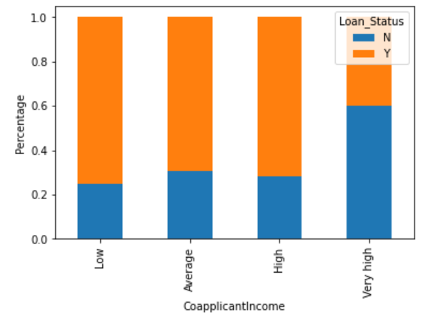
Milestone-2
Loan Status by Co-applicant Income
It shows that if co-applicants income is less the chances of loan approval are high.
But this does not look right.
The possible reason behind this may be that most of the applicants don't have any co-applicant so the co-applicant income for such applicants is 0 and hence the loan approval is not dependent on it.
So, A new variable can be created combining the applicant's and co-applicants income to visualize the combined effect of income on loan approval.

Slide 19
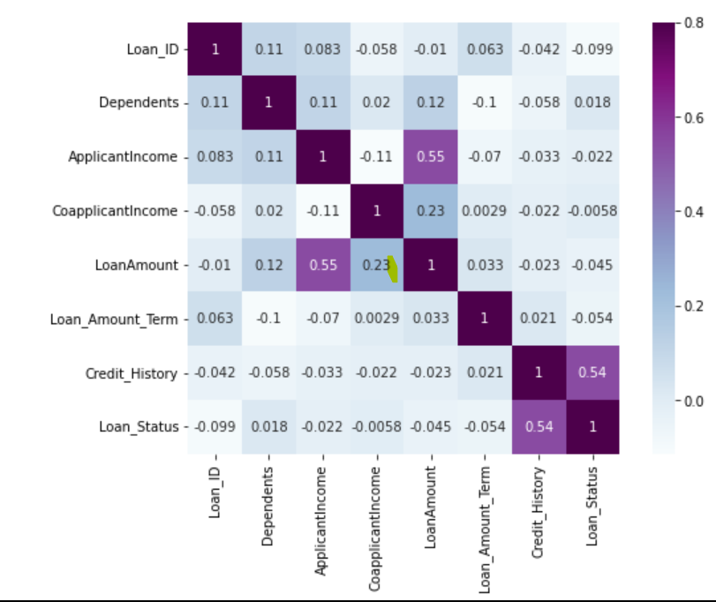
Milestone-2
Multi Variate Analysis
The variables with darker color means their correlation is more.
We see that the most correlated variables are
ApplicantIncome - LoanAmount and Credit_History - Loan_Status.
LoanAmount is also correlated with CoapplicantIncome.

Slide 20
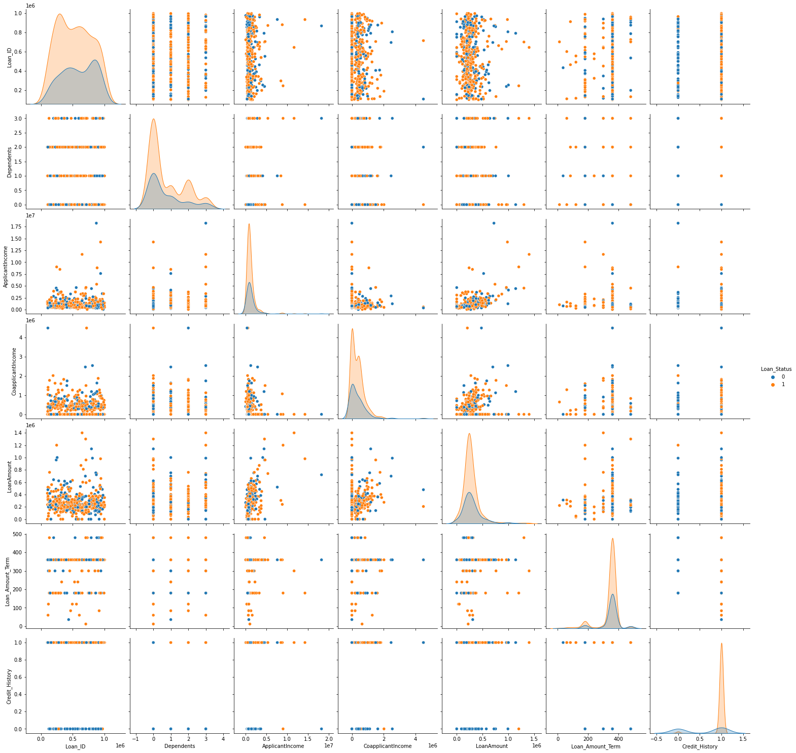
Milestone-2

Slide 21
Milestone-3
Project Milestone-3 has the following objectives
Create transformed features in the existing feature set - wherever required and provide reasons for the transformations
Identify new features that can be created from the existing feature set and back that up with business/statistical logic
Do feature importance analysis in various ways
Drop features that are not required or useful for analysis
Data pre processing like missing value imputation or outlier imputation

Slide 22
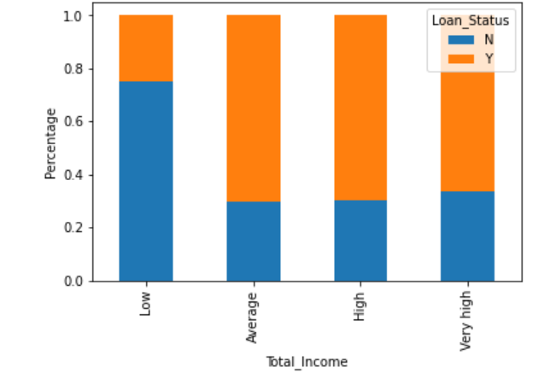
Milestone-3
Feature Engineering
Create a new feature Total_Income combining applicant and coapplicant's income.
This Shows Applicants having low total income have less chance of loan sanction which seems right from business insights
[Where, low=(0-500000), Average=(500001-100000), High=(1000001-2000000) , Very high=(2000000-19225000)]

Slide 23
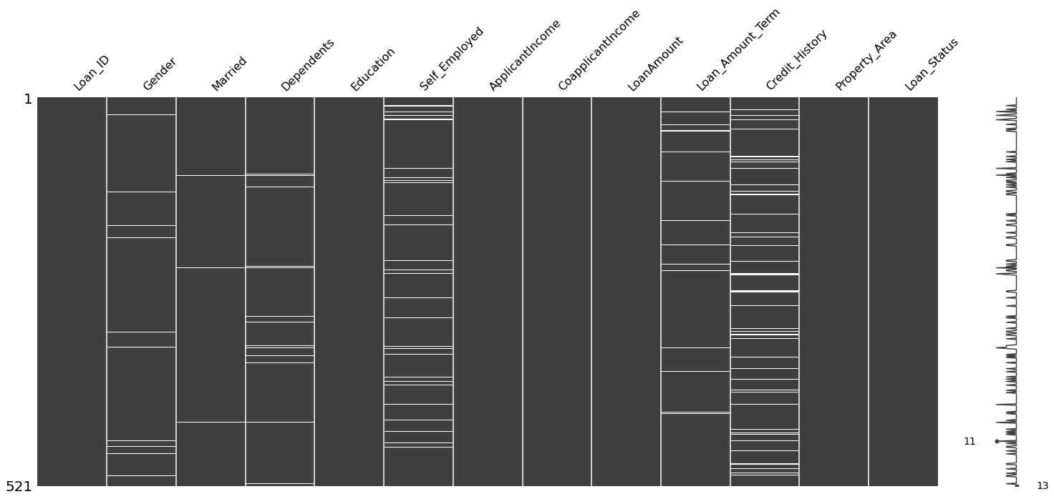
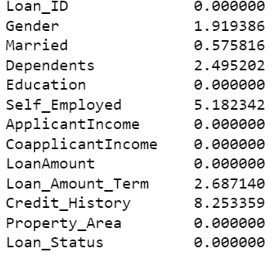
Milestone-3
Missing Values
Missing Values in %
Missing Values Matrix

Slide 24
MISSING VALUE IMPUTATION
There are very less missing values in Gender, Married, Dependents, Credit_History and Self_Employed features so we can fill them using the mode of the features.
Earlier we have seen that in Loan_Amount_Term variable, the value of 360 is repeating the most. So we will replace the missing values in this variable using the mode of this variable.
Loan amount can not be 0. This may be assumed as missing value. We will use the median to fill the null values as earlier we saw that the loan amount has outliers

Slide 25
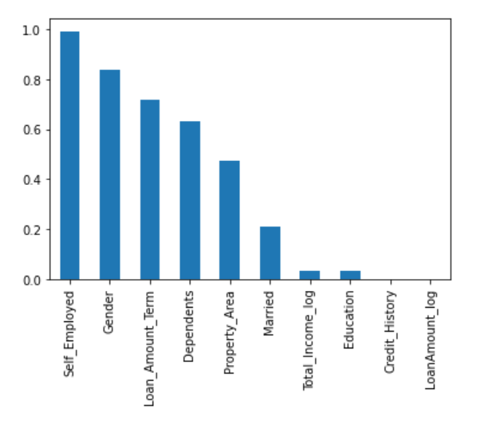
Milestone-3
Feature Importance
From the chi2 test, we have found the p-values for categorical independent variable
Features having p value > 0.5 have less impact on target feature
Self_Employed
Gender
Loan_Amount_Term
Dependents

Slide 26
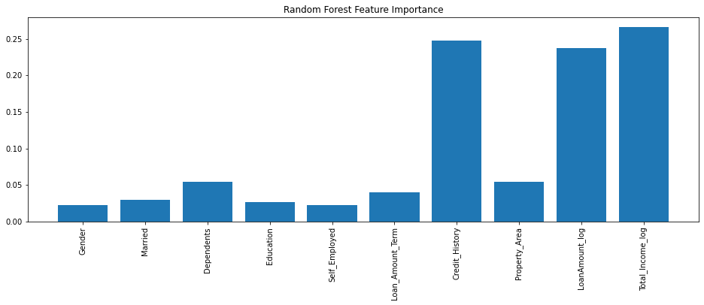
Milestone-3
Feature importance by Random Forest
Credit history, Total income, Loan amount have good importance among all the features
Gender, Self_Employed have the least importance

Slide 27
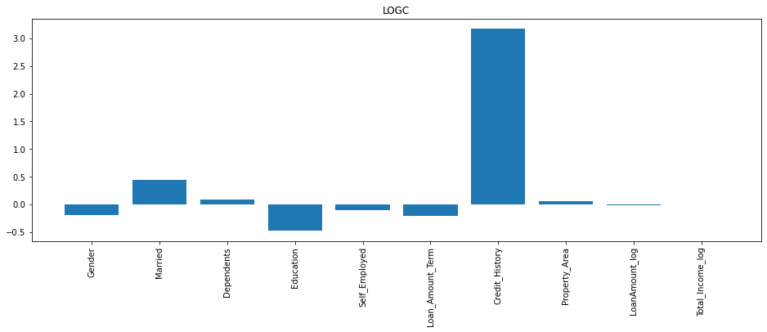
Milestone-3
Feature importance by Logistic Regression
Credit history has highest importance among all the features
Property area has the least importance
After analyzing feature importance
we can drop following features
Gender
Dependents
Self_Employed
Loan_Amount_Term

Slide 28
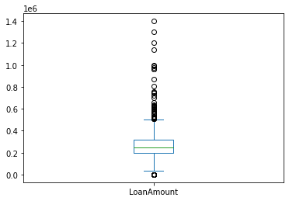
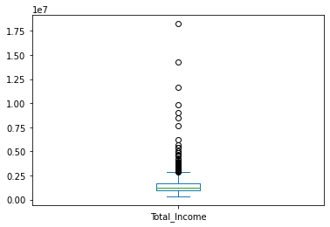
Milestone-3
Outliers Detection
Boxplot able to find presence of outliers in feature Loan amount and Total_income

Slide 29
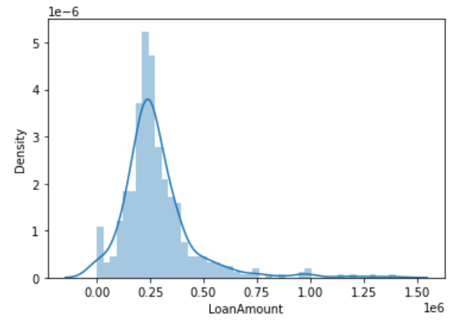
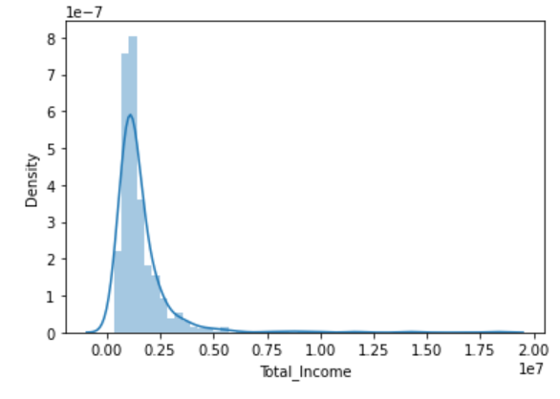
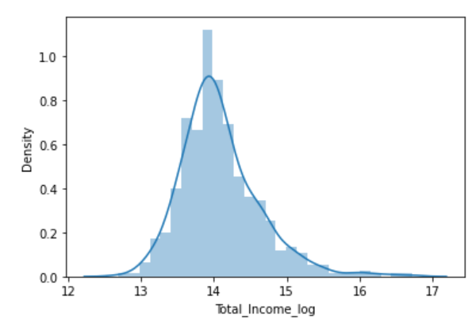
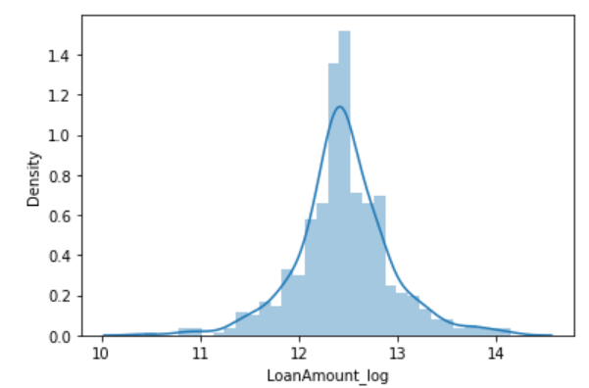
Milestone-3
Outlier Treatment
Log transformations applied to feature that contains outliers. This change a right skewed distribution to normal distribution.
Total_Income
Loan Amount

Slide 30
Milestone-4
Project Milestone-4 has the following objectives
Create various models based on features and target variable
Evaluate the best model based on different evaluation parameters - Parameter tuning.
Build a conclusive visual report on evaluation parameter.
Give a brief and inferences about each and each model based on all evaluation parameter.
Implement the best model on test data set and show the metrics in visual or tabular format

Slide 31
Milestone-4
Model Training
We will use the train_test_split function with test size 30% from sklearn to divide our train dataset.
Stratified 5 folds used to make predictions for test dataset on the following Classification models.
Logistic Regression
Decision Tree
Random Forest
XG Boost
AdaBoost
KNeighbors
Naïve Bayes
Support Vector Machine

Slide 32
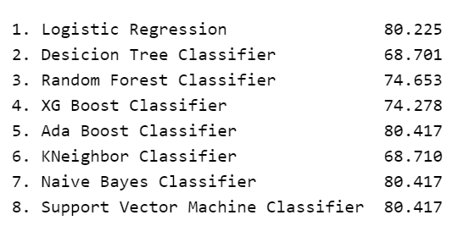
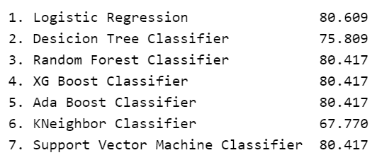
Milestone-4
Hyper Parameters Tuning
Randomized Search CV is applied to improve the accuracy by tuning the hyper parameters for all the models
Model Accuracy before hyper tuning of parameters
Model Accuracy after hyper tuning of parameters

Slide 33
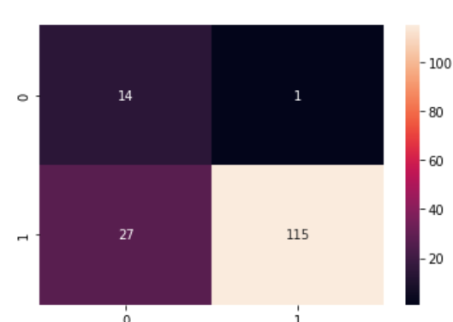
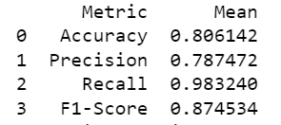
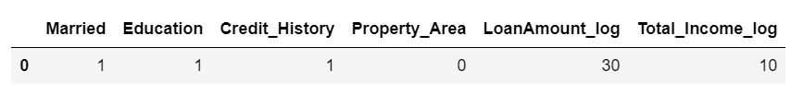


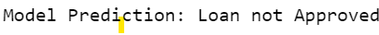
Milestone-4
Best Model Implementation
Highest Accuracy is shown in Logistic Regression
The best parameter from hyper tuning was
LogisticRegression(C=1, max_iter=300, penalty='l1', solver='liblinear’)
Evaluation parameters are
Confusion Matrix

Slide 34
SUMMARY
In conclusion, the Credit worthiness project successfully navigated through key stages, from data exploration to model testing & validation.
The Logistic Regression model, with its high accuracy and balanced performance on precision and recall, proved to be a robust solution for predicting loan approval outcomes.
This project's thorough approach to data analysis, feature engineering, and model training contributes to its practical utility in assisting lending institutions with informed decision-making.

Slide 35
Thank You

